Slide 1
Image Processing Operations

Slide 2
Image Histogram
Histogram of an image provides a global description of the appearance of an image.
It provides a useful visualization of the frequency of occurrence of different pixel intensities in the image.
The x-axis of the histogram represents the pixel intensity values, while the y-axis shows the number of pixels with each intensity value.
Image histograms are widely used in image processing and computer vision for various purposes, including image enhancement, contrast adjustment, thresholding, and image analysis.
By analyzing the histogram, one can gain insights into the overall brightness, contrast, and tonal range of an image.

Slide 3
Image Histogram
Intensity Range: The range of pixel intensity values typically spans from 0 to 255 in an 8-bit grayscale image. In color images, histograms are often computed for each color channel (Red, Green, Blue) separately.
Brightness and Contrast: The shape of the histogram indicates the overall brightness and contrast of the image. A peak in the center of the histogram suggests a balanced distribution of pixel intensities, resulting in a well-exposed image with good contrast. An image with low contrast may have a narrow histogram, while an image with high contrast may have a broad histogram.
Bimodal Histograms: Bimodal histograms have two distinct peaks, indicating the presence of two dominant regions in the image. Such histograms are often encountered in images with distinct foreground and background regions..
Skewed Histograms: Skewed histograms have a bias towards high or low pixel intensities. Skewed histograms may indicate overexposure or underexposure in certain areas of the image.

Slide 4
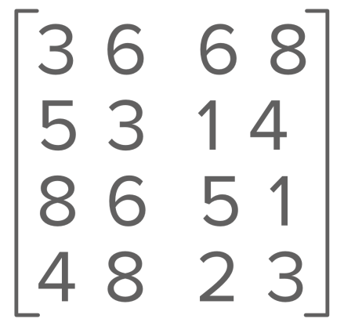
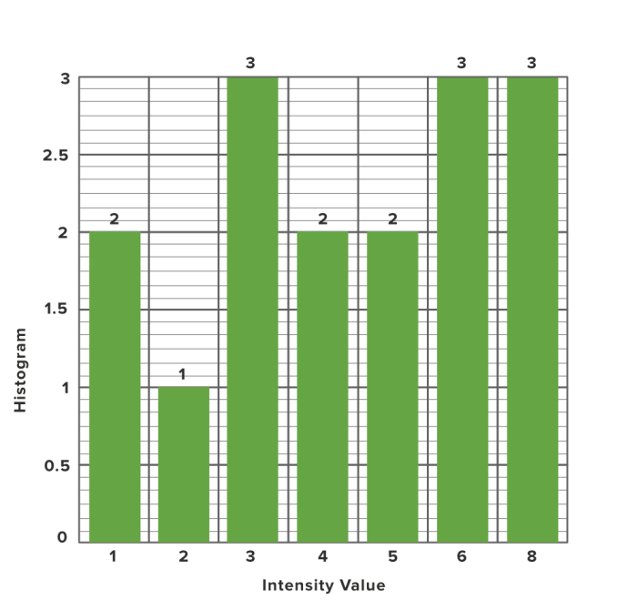
Histogram Plot: Method 1
In this method, the x-axis has grey levels/ Intensity values and the y-axis has the number of pixels in each grey level. The Histogram value representation of the above image is:

Slide 5
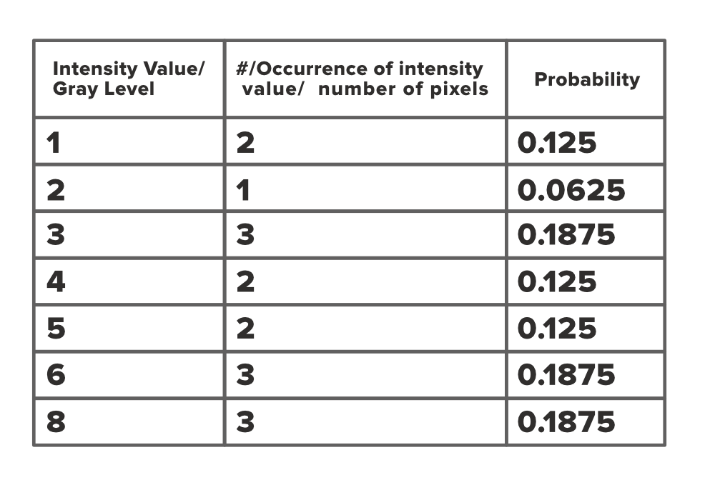
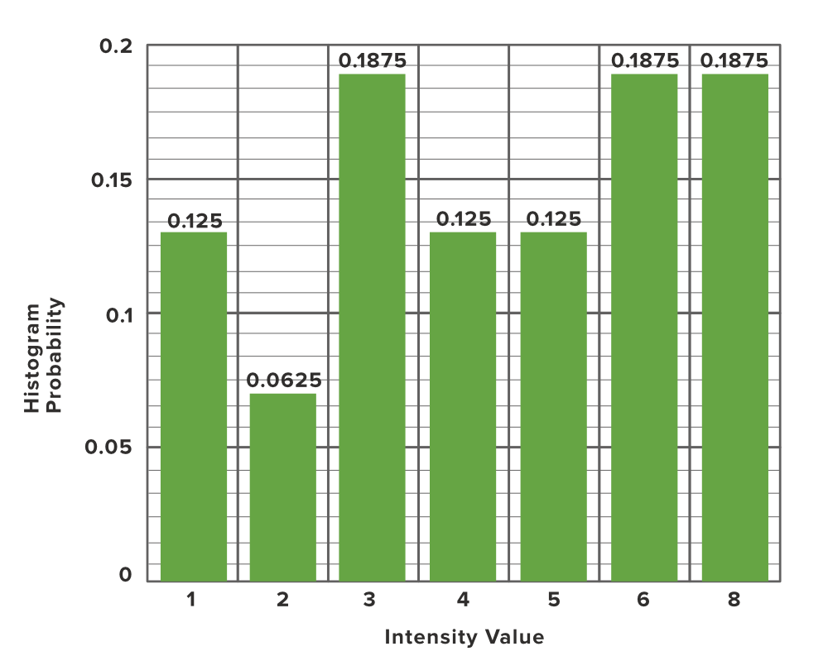
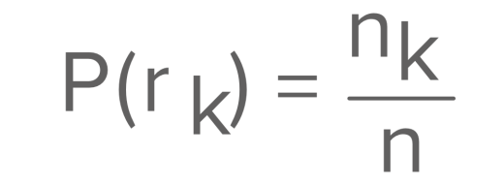
Histogram Plot: Method 2
In this method, the x-axis represents the grey level, while the y-axis represents the probability of occurrence of that grey level.

Slide 6
Reading an Image (OpenCV)
Syntax: cv2.imread(path, flag)
Parameters:
path: A string representing the path of the image to be read.
flag: It specifies the way in which image should be read. It’s default value is cv2.IMREAD_COLOR
cv2.IMREAD_COLOR: It specifies to load a color image. Any transparency of image will be neglected. It is the default flag. Alternatively, we can pass integer value 1 for this flag.
cv2.IMREAD_GRAYSCALE: It specifies to load an image in grayscale mode. Alternatively, we can pass integer value 0 for this flag.
cv2.IMREAD_UNCHANGED: It specifies to load an image as such including alpha channel. Alternatively, we can pass integer value -1 for this flag.

Slide 7
Reading an Image (OpenCV)
import cv2
img = cv2.imread("geeksforgeeks.png", cv2.IMREAD_COLOR)
cv2.imshow("image", img)
cv2.waitKey(0)
cv2.destroyAllWindows()

Slide 8
Reading an Image (OpenCV)
import cv2
import numpy as np
import matplotlib.pyplot as plt
img = cv2.imread("geeksforgeeks.png", cv2.IMREAD_COLOR)
plt.imshow(img)
cv2.waitKey(0)
cv2.destroyAllWindows()

Slide 9
Histogram Calculation (OpenCV)
cv2.calcHist(images, channels, mask, histSize, ranges[, hist[, accumulate]])
images : it is the source image of type uint8 or float32 represented as “[img]”. channels : it is the index of channel for which we calculate histogram. For grayscale image, its value is [0] and color image, you can pass [0], [1] or [2] to calculate histogram of blue, green or red channel respectively. mask : mask image. To find histogram of full image, it is given as “None”. histSize : this represents our BIN count. For full scale, we pass [256]. ranges : this is our RANGE. Normally, it is [0,256].

Slide 10
Program for Image Histogram
# importing required libraries of opencv
import cv2
# importing library for plotting
from matplotlib import pyplot as plt
# reads an input image
img = cv2.imread('ex.jpg',0)
# find frequency of pixels in range 0-255
histr = cv2.calcHist([img],[0],None,[256],[0,256])
# show the plotting graph of an image
plt.plot(histr)
plt.show()

Slide 11
Binarization (Thresholding)
Thresholding is a fundamental technique in image processing used to separate objects or regions of interest from the background in a grayscale image.
Thresholding is a fundamental technique in image processing used to separate objects or regions of interest from the background in a grayscale image.
The threshold value is a user-defined parameter that determines the separation between the foreground (objects of interest) and the background in the image.
The process of thresholding is straightforward and is widely used for image segmentation, object detection, and feature extraction.

Slide 12
Different Thresholding methods
Global Thresholding: In global thresholding, a single threshold value is applied to the entire image. All pixel intensities above the threshold are set to one value (usually 255, white), and all intensities below the threshold are set to another value (usually 0, black). The choice of the threshold value is crucial and can significantly impact the quality of the resulting binary image.
Adaptive Thresholding: Adaptive thresholding is used when the illumination conditions vary across the image. Instead of applying a single threshold to the entire image, adaptive thresholding uses a local threshold value for each pixel based on the neighborhood of that pixel. This approach is useful for handling uneven lighting conditions.
Triangle Thresholding: Triangle thresholding calculates a threshold value that corresponds to the midpoint of the intensity distribution of the image.
Otsu's Thresholding: Otsu's thresholding is an automatic thresholding technique that finds the optimal threshold value by maximizing the variance between the two classes of pixels (foreground and background). It is effective when the separation between the foreground and background pixel intensities is distinct.
Binary Inverse Thresholding: Binary inverse thresholding is similar to global thresholding, but the black and white regions are reversed. Pixels above the threshold are set to 0 (black), and pixels below the threshold are set to 255 (white).

Slide 13
Program 1: Global Thresholding
Syntax: cv2.threshold(source, thresholdValue, maxVal, thresholdingTechnique)
source: Input Image array (must be in Grayscale).
thresholdValue: Value of Threshold below and above which pixel values will change accordingly.
maxVal: Maximum value that can be assigned to a pixel.
thresholdingTechnique: The type of thresholding to be applied.
Thresholding Tevhniques
cv2.THRESH_BINARY: If pixel intensity is greater than the set threshold, value set to 255, else set to 0 (black).
cv2.THRESH_BINARY_INV: Inverted or Opposite case of cv2.THRESH_BINARY.
cv.THRESH_TRUNC: If pixel intensity value is greater than threshold, it is truncated to the threshold. The pixel values are set to be the same as the threshold. All other values remain the same.
cv.THRESH_TOZERO: Pixel intensity is set to 0, for all the pixels intensity, less than the threshold value.
cv.THRESH_TOZERO_INV: Inverted or Opposite case of cv2.THRESH_TOZERO.

Slide 14
Program
import cv2
import numpy as np
image1 = cv2.imread('input1.jpg')
img = cv2.cvtColor(image1, cv2.COLOR_BGR2GRAY)
ret, thresh1 = cv2.threshold(img, 120, 255, cv2.THRESH_BINARY)
ret, thresh2 = cv2.threshold(img, 120, 255, cv2.THRESH_BINARY_INV)
ret, thresh3 = cv2.threshold(img, 120, 255, cv2.THRESH_TRUNC)
ret, thresh4 = cv2.threshold(img, 120, 255, cv2.THRESH_TOZERO)
ret, thresh5 = cv2.threshold(img, 120, 255, cv2.THRESH_TOZERO_INV)
cv2.imshow('Binary Threshold', thresh1)
cv2.imshow('Binary Threshold Inverted', thresh2)
cv2.imshow('Truncated Threshold', thresh3)
cv2.imshow('Set to 0', thresh4)
cv2.imshow('Set to 0 Inverted', thresh5)
# De-allocate any associated memory usage
if cv2.waitKey(0) & 0xff == 27:
cv2.destroyAllWindows()

Slide 15
Adaptive Thresholding
Syntax: cv2.adaptiveThreshold(source, maxVal, adaptiveMethod, thresholdType, blocksize, constant)\
source: Input Image array(Single-channel, 8-bit or floating-point)
maxVal: Maximum value that can be assigned to a pixel.
adaptiveMethod: Adaptive method decides how threshold value is calculated.
cv2.ADAPTIVE_THRESH_MEAN_C: Threshold Value = (Mean of the neighbourhood area values – constant value). In other words, it is the mean of the blockSize×blockSize neighborhood of a point minus constant.
cv2.ADAPTIVE_THRESH_GAUSSIAN_C: Threshold Value = (Gaussian-weighted sum of the neighbourhood values – constant value). In other words, it is a weighted sum of the blockSize×blockSize neighborhood of a point minus constant.
-> thresholdType: The type of thresholding to be applied. -> blockSize: Size of a pixel neighborhood that is used to calculate a threshold value. -> constant: A constant value that is subtracted from the mean or weighted sum of the neighbourhood pixels.

Slide 16
Program
import cv2
import numpy as np
image1 = cv2.imread('input1.jpg')
img = cv2.cvtColor(image1, cv2.COLOR_BGR2GRAY)
thresh1 = cv2.adaptiveThreshold(img, 255, cv2.ADAPTIVE_THRESH_MEAN_C,v2.THRESH_BINARY, 199, 5)
thresh2 = cv2.adaptiveThreshold(img, 255, cv2.ADAPTIVE_THRESH_GAUSSIAN_C,cv2.THRESH_BINARY, 199, 5)
cv2.imshow('Adaptive Mean', thresh1)
cv2.imshow('Adaptive Gaussian', thresh2)
if cv2.waitKey(0) & 0xff == 27:
cv2.destroyAllWindows()

Slide 17
Otsu Thresholding
cv2.threshold(source, thresholdValue, maxVal, thresholdingTechnique)
-> source: Input Image array (must be in Grayscale). -> thresholdValue: Value of Threshold below and above which pixel values will change accordingly. -> maxVal: Maximum value that can be assigned to a pixel. -> thresholdingTechnique: The type of thresholding to be applied.

Slide 18
Program
import cv2
import numpy as np
image1 = cv2.imread('input1.jpg')
img = cv2.cvtColor(image1, cv2.COLOR_BGR2GRAY)
ret, thresh1 = cv2.threshold(img, 120, 255, cv2.THRESH_BINARY + cv2.THRESH_OTSU)
cv2.imshow('Otsu Threshold', thresh1)
# De-allocate any associated memory usage
if cv2.waitKey(0) & 0xff == 27:
cv2.destroyAllWindows()

Slide 19
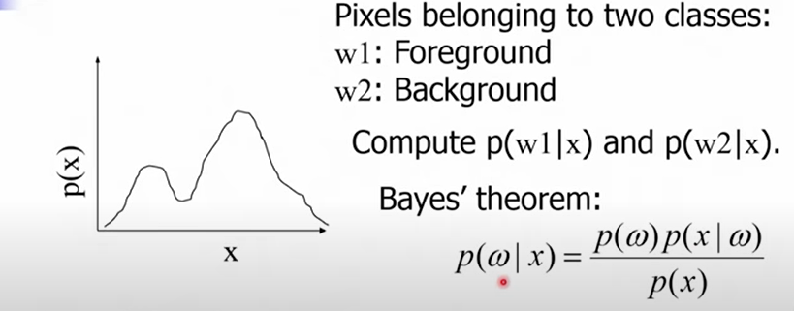

Bayesian Classification of Foreground and Background Pixels
Bimodal histograms are histograms that exhibit two distinct peaks, indicating the presence of two dominant regions or groups of pixel intensities in an image.

Slide 20
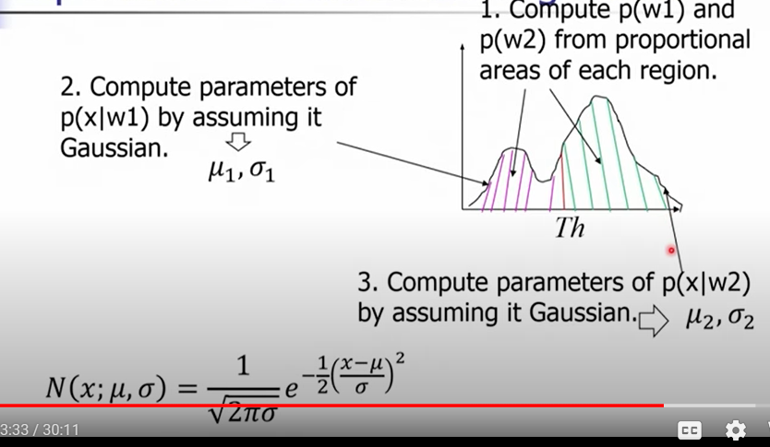
Expectation Maximization Algorithm

Slide 21
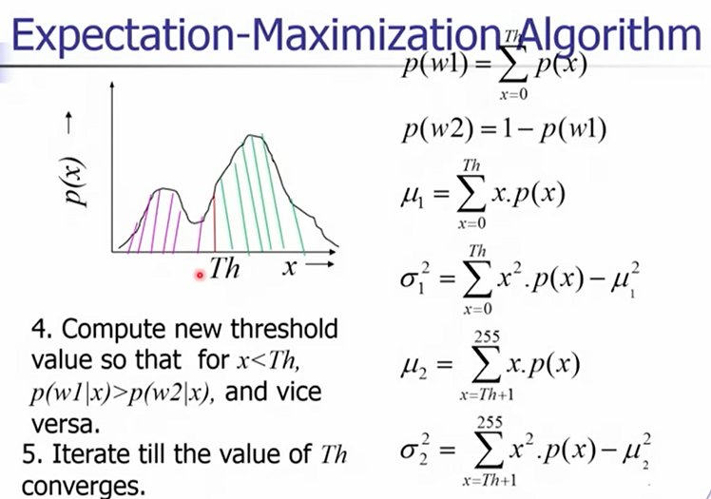

Slide 22
Thanks

